Slide 1
Chapter Fourteen
Profit-Maximization
利润最大化

Slide 2
Structure
Economic profit
Short-run profit maximization
  Comparative statics
Long-run profit maximization
Profit maximization and returns to scale

Slide 3
Economic Profit
A firm uses inputs j = 1…,m to make products i = 1,…n.
Output levels are y₁,…,y_{n}.
Input levels are x₁,…,x_{m}.
Product prices are p₁,…,p_{n}.
Input prices are w₁,…,w_{m.}

Slide 4
The Competitive Firm
The competitive firm takes all output prices p₁,…,p_{n} and all input prices w₁,…,w_{m} as given constants.

Slide 5

Economic Profit
The economic profit generated by the production plan (x₁,…,x_{m},y₁,…,y_{n}) is

Slide 6
Economic Profit
Output and input levels are typically flows.
E.g. x₁ might be the number of labor units used per hour.
And y₃ might be the number of cars produced per hour.
Consequently, profit is typically a flow also; e.g. the number of dollars of profit earned per hour.

Slide 7
Opportunity Costs (机会成本)
All inputs must be valued at their market value.
Labor
Capital

Slide 8
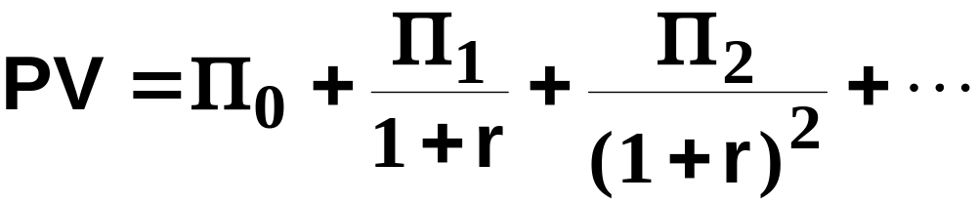
Economic Profit
How do we value a firm?
Suppose the firm’s stream of periodic economic profits is Π₀, Π₁, Π₂, … and r is the rate of interest.
Then the present-value of the firm’s economic profit stream is

Slide 9
Profit Maximization
A competitive firm seeks to maximize its present-value.
How?

Slide 10
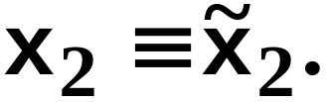
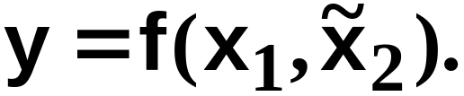
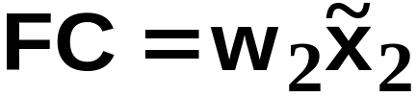
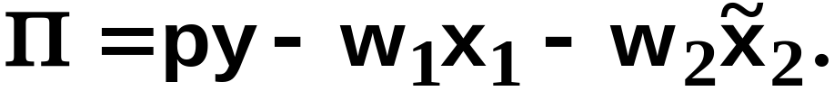
Short-Run Profit Maximization
Suppose the firm is in a short-run circumstance in which
Its short-run production function is
The firm’s fixed cost is
and its profit function is

Slide 11
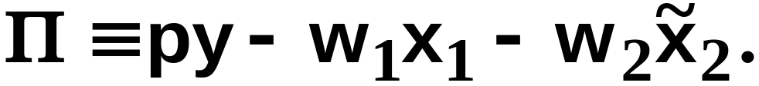
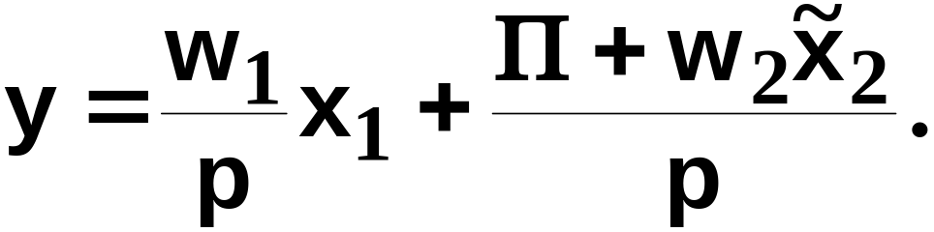
Short-Run Iso-Profit Lines
A $Π iso-profit line (等利润线) contains all the production plans that yield a profit level of $Π .
The equation of a $Π iso-profit line is
I.e.

Slide 12
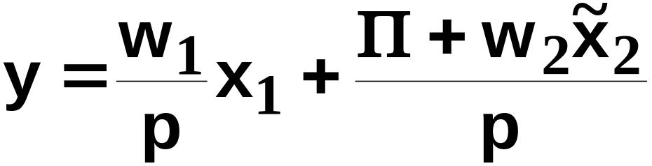
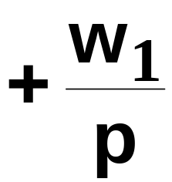
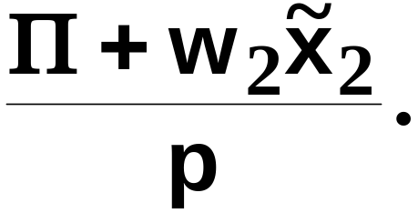
Short-Run Iso-Profit Lines
has a slope of
and a vertical intercept of

Slide 13



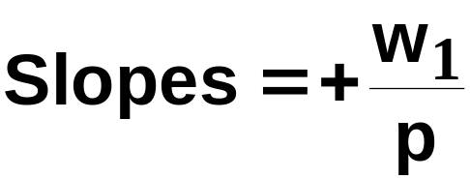
Short-Run Iso-Profit Lines
y
Increasing
profit
x₁

Slide 14
Short-Run Profit-Maximization
The firm’s problem is to locate the production plan that attains the highest possible iso-profit line, given the firm’s constraint on choices of production plans.
Q: What is this constraint?
A: The production function.

Slide 15

Short-Run Profit-Maximization
y
The short-run production function and
technology set for
Technically
inefficient
plans
x₁

Slide 16
Short-Run Profit-Maximization
y
Increasing
profit
x₁

Slide 17


Short-Run Profit-Maximization
y
x₁

Slide 18

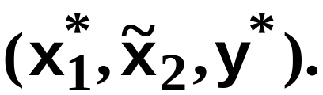
Short-Run Profit-Maximization
Given p, w₁ and the short-run
profit-maximizing plan is
y
x₁

Slide 19

Short-Run Profit-Maximization
Given p, w₁ and the short-run
profit-maximizing plan is
And the maximum
possible profit
is
y
x₁

Slide 20
Short-Run Profit-Maximization
At the short-run profit-maximizing plan, the slopes of the short-run production function and the maximal
iso-profit line are
equal.
y
x₁

Slide 21
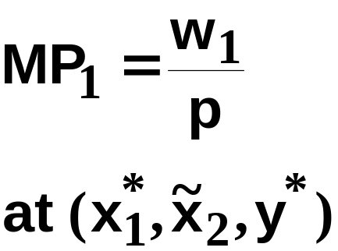
Short-Run Profit-Maximization
At the short-run profit-maximizing plan, the slopes of the short-run production function and the maximal
iso-profit line are
equal.
y
x₁

Slide 22
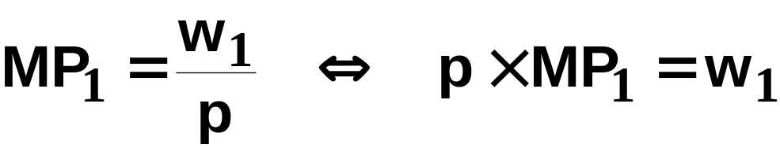



Short-Run Profit-Maximization
is the marginal revenue product(边际
收益产量) of input 1, the rate at which revenue
Increases with the amount used of input 1.
If then profit increases with x₁.
If then profit decreases with x₁.

Slide 23
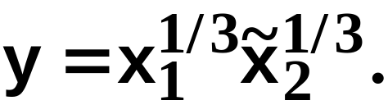
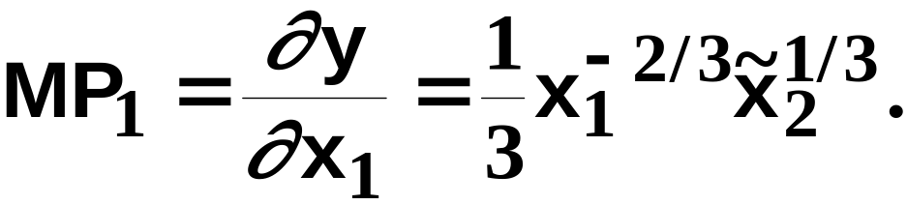
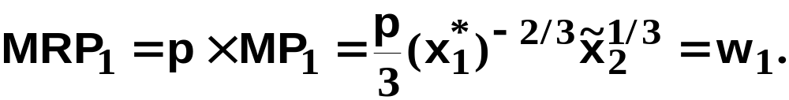
Short-Run Profit-Maximization; A Cobb-Douglas Example
Suppose the short-run production
function is
The marginal product of the variable
input 1 is
The profit-maximizing condition is

Slide 24
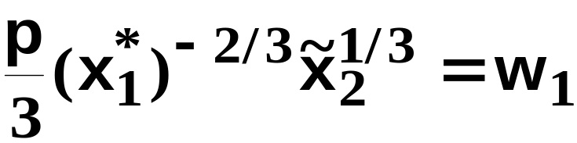
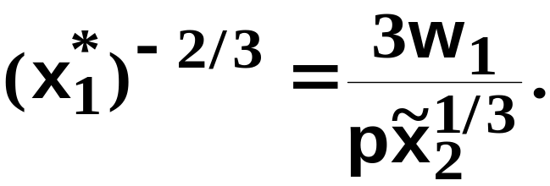
Short-Run Profit-Maximization; A Cobb-Douglas Example
Solving
for x₁ gives

Slide 25
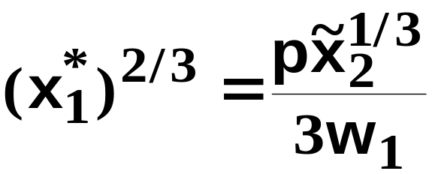
Short-Run Profit-Maximization; A Cobb-Douglas Example
Solving
for x₁ gives
That is,

Slide 26
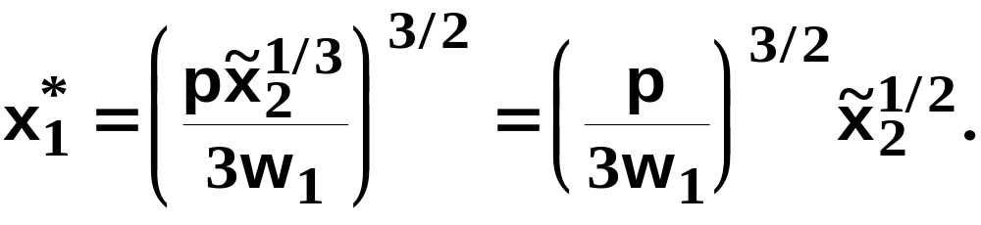
Short-Run Profit-Maximization; A Cobb-Douglas Example
Solving
for x₁ gives
That is,
so

Slide 27
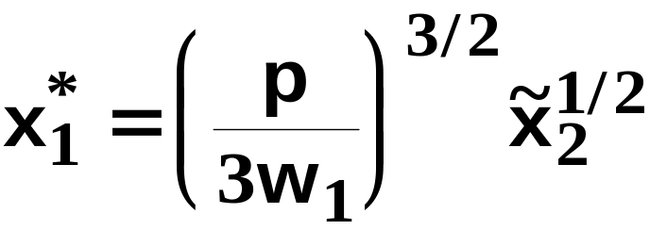

Short-Run Profit-Maximization; A Cobb-Douglas Example
is the firm’s
short-run demand
for input 1 when the level of input 2 is fixed at units.

Slide 28
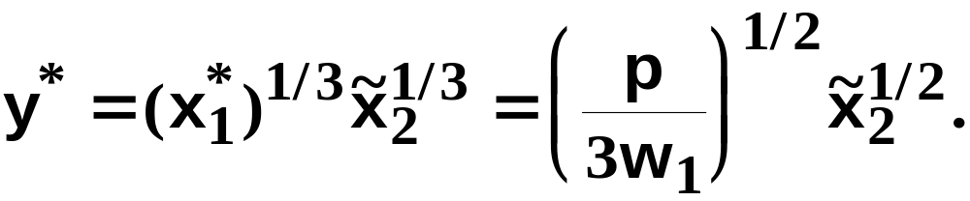
Short-Run Profit-Maximization; A Cobb-Douglas Example
is the firm’s
short-run demand
for input 1 when the level of input 2 is fixed at units.
The firm’s short-run output level is thus

Slide 29
Comparative Statics of Short-Run Profit-Maximization
What happens to the short-run profit-maximizing production plan as the output price p changes?

Slide 30
Comparative Statics of Short-Run Profit-Maximization
The equation of a short-run iso-profit line
is
so an increase in p causes
-- a reduction in the slope, and
-- a reduction in the vertical intercept.

Slide 31
Comparative Statics of Short-Run Profit-Maximization
y
x₁

Slide 32
Comparative Statics of Short-Run Profit-Maximization
y
x₁

Slide 33
Comparative Statics of Short-Run Profit-Maximization
y
x₁

Slide 34
Comparative Statics of Short-Run Profit-Maximization
An increase in p, the price of the firm’s output, causes
  an increase in the firm’s output level (the firm’s supply curve slopes upward), and
  an increase in the level of the firm’s variable input (the firm’s demand curve for its variable input shifts outward).

Slide 35
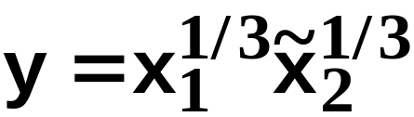

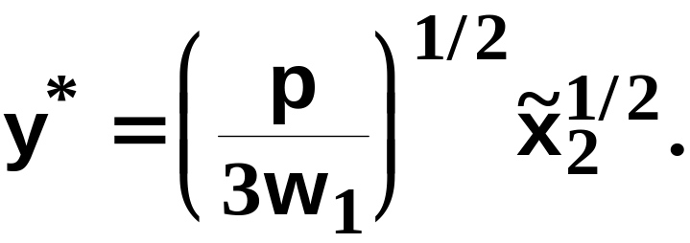
Comparative Statics of Short-Run Profit-Maximization
The Cobb-Douglas example: When
then the firm’s short-run
demand for its variable input 1 is
and its short-run
supply is

Slide 36

Comparative Statics of Short-Run Profit-Maximization
The Cobb-Douglas example: When
then the firm’s short-run
demand for its variable input 1 is
and its short-run
supply is
increases as p increases.

Slide 37

Comparative Statics of Short-Run Profit-Maximization
The Cobb-Douglas example: When
then the firm’s short-run
demand for its variable input 1 is
and its short-run
supply is
increases as p increases.
increases as p increases.

Slide 38
Comparative Statics of Short-Run Profit-Maximization
What happens to the short-run profit-maximizing production plan as the variable input price w₁ changes?

Slide 39
Comparative Statics of Short-Run Profit-Maximization
The equation of a short-run iso-profit line
is
so an increase in w₁ causes
-- an increase in the slope, and
-- no change to the vertical intercept.

Slide 40
Comparative Statics of Short-Run Profit-Maximization
y
x₁

Slide 41
Comparative Statics of Short-Run Profit-Maximization
y
x₁

Slide 42
Comparative Statics of Short-Run Profit-Maximization
y
x₁

Slide 43
Comparative Statics of Short-Run Profit-Maximization
An increase in w₁, the price of the firm’s variable input, causes
  a decrease in the firm’s output level (the firm’s supply curve shifts inward), and
  a decrease in the level of the firm’s variable input (the firm’s demand curve for its variable input slopes downward).

Slide 44
Comparative Statics of Short-Run Profit-Maximization
The Cobb-Douglas example: When
then the firm’s short-run
demand for its variable input 1 is
and its short-run
supply is

Slide 45
Comparative Statics of Short-Run Profit-Maximization
The Cobb-Douglas example: When
then the firm’s short-run
demand for its variable input 1 is
and its short-run
supply is
decreases as w₁ increases.

Slide 46
Comparative Statics of Short-Run Profit-Maximization
The Cobb-Douglas example: When
then the firm’s short-run
demand for its variable input 1 is
and its short-run
supply is
decreases as w₁ increases.
decreases as w₁ increases.

Slide 47
Long-Run Profit-Maximization
Now allow the firm to vary both input levels, i.e., both x₁ and x₂ are variable.
Since no input level is fixed, there are no fixed costs.

Slide 48
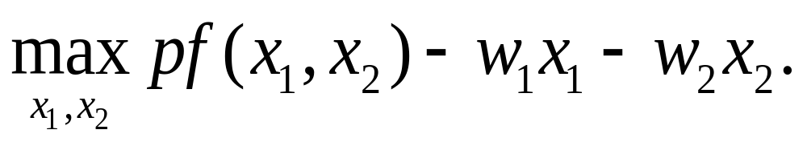
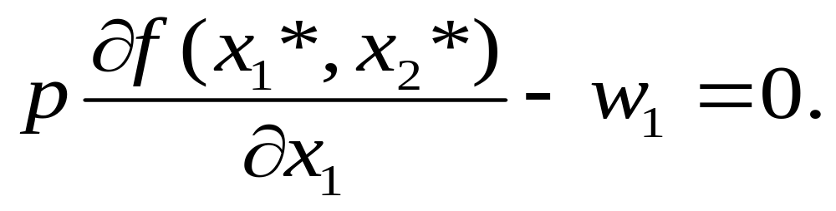
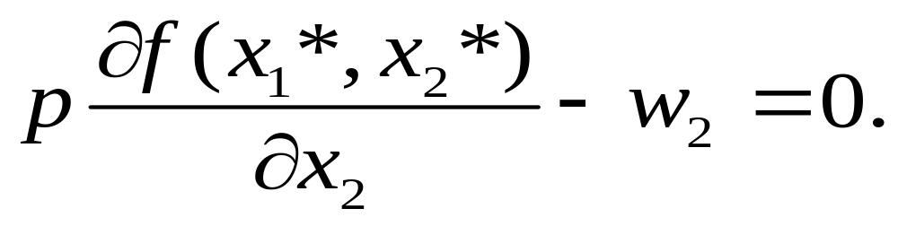
Long-Run Profit-Maximization
The profit-maximization problem is
FOCs are:

Slide 49
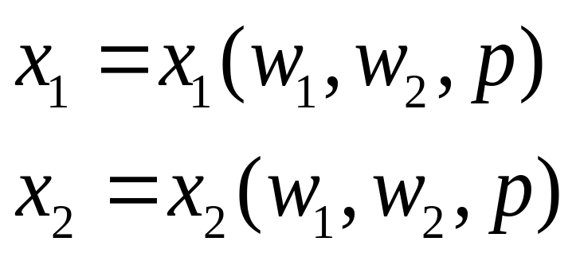
Factor Demand Functions
Demand for inputs 1 and 2 can be solved as,

Slide 50
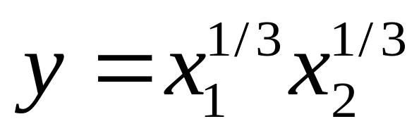
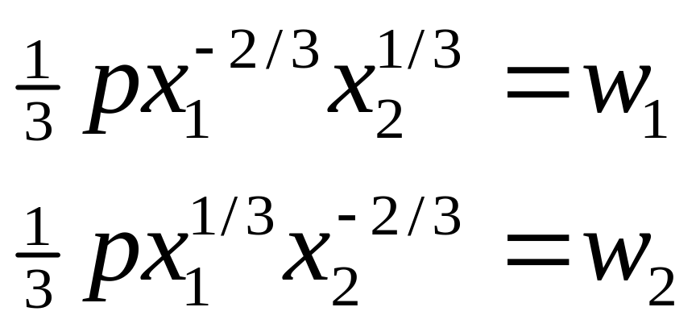
Example: C-D Production Function
The production function is
First-order conditions are:

Slide 51
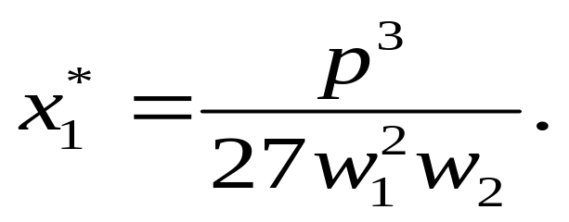
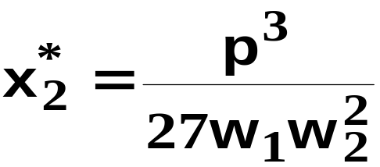
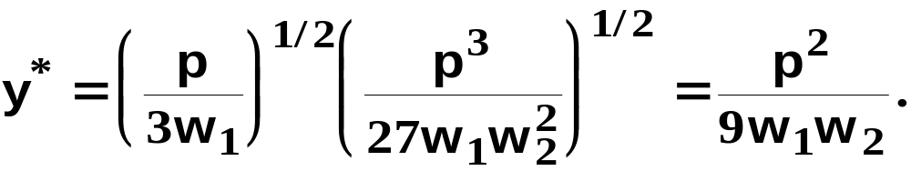
Example: C-D Production Function
Solving for x₁ and x₂ :
Plug-in production function to get:

Slide 52
Returns-to-Scale and Profit-Maximization
If a competitive firm’s technology exhibits decreasing returns-to-scale then the firm has a single long-run profit-maximizing production plan.

Slide 53

Returns-to Scale and Profit-Maximization
y
y*
Decreasing
returns-to-scale
x*
x

Slide 54
Returns-to-Scale and Profit-Maximization
If a competitive firm’s technology exhibits exhibits increasing returns-to-scale then the firm does not have a profit-maximizing plan.

Slide 55
Returns-to Scale and Profit-Maximization
y
Increasing
profit
y”
y’
Increasing
returns-to-scale
x’
x”
x

Slide 56
Returns-to-Scale and Profit-Maximization
So an increasing returns-to-scale technology is inconsistent with firms being perfectly competitive.

Slide 57
Returns-to-Scale and Profit-Maximization
What if the competitive firm’s technology exhibits constant returns-to-scale?

Slide 58
Returns-to Scale and Profit-Maximization
y
Increasing
profit
y”
Constant
returns-to-scale
y’
x’
x”
x

Slide 59
Returns-to Scale and Profit-Maximization
So if any production plan earns a positive profit, the firm can double up all inputs to produce twice the original output and earn twice the original profit.

Slide 60
Returns-to Scale and Profit-Maximization
Therefore, when a firm’s technology exhibits constant returns-to-scale, earning a positive economic profit is inconsistent with firms being perfectly competitive.
Hence constant returns-to-scale requires that competitive firms earn economic profits of zero.

Slide 61
Returns-to Scale and Profit-Maximization
y
Π = 0
y”
Constant
returns-to-scale
y’
x’
x”
x

